Slide 1
MOIVEO Web App

Slide 2

Project Summary
Title: MOIVEO - Movie Streaming Platform
Overview: A dark-themed, responsive web app for browsing movies and TV shows using the TMDB API.
Features: Trending, Now Playing, Top Rated, Popular TV, On The Air, Search.
Tech Stack: React.js, Axios/Fetch, TailwindCSS, TMDB API.
Created by: DEPI TEAM
Deployment: movie-recommendation-nu-five.vercel.app

Slide 3
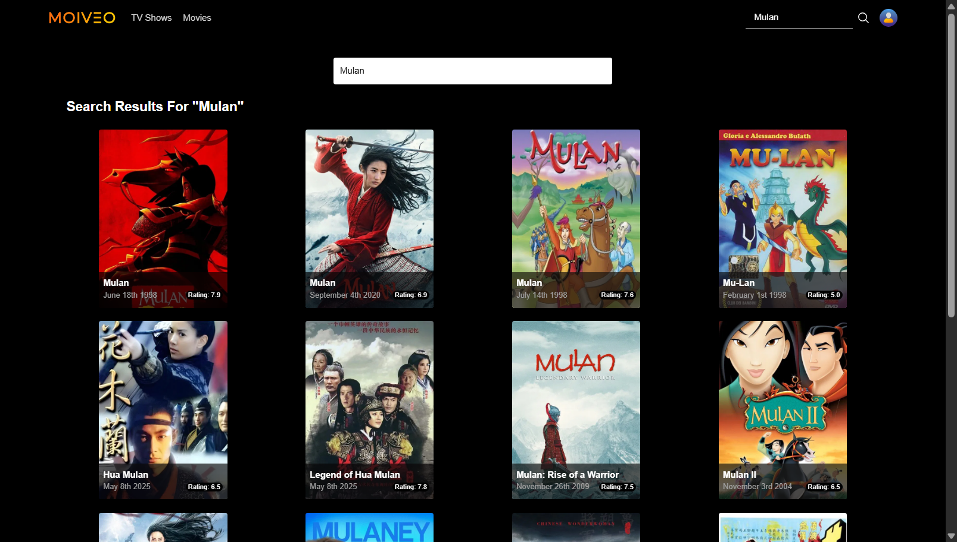
Project Documentation
Installation:
Clone: git clone https://github.com/mohammed1215/Movie-Recommendation.git
Navigate: cd Movie-Recommendation
Install: npm install
Setup .env: API_KEY=your_tmdb_api_key
Requirements:
Node.js (14.x+), npm (6.x+), Git (2.25+), Browser (Chrome/Firefox/Safari)
Dependencies: React.js, Axios/Fetch, TailwindCSS, TMDB API

Slide 4
Configuration:
Add TMDB API key to .env.
Update src/data/movies.json or API calls.
Edit src/styles/App.css for styling.
Running:
Local: npm run dev, visit http://localhost:5173
Build: npm run build
Deploy: npm install -g vercel, vercel

Slide 5
API:
TMDB Endpoints:
/movie/now_playing
/tv/on_the_air
/movie/top_rated
/trending/all/week
/tv/popular
/search/multi
Parameters: api_key, query
Response: JSON (title, date, rating, poster)

Slide 6
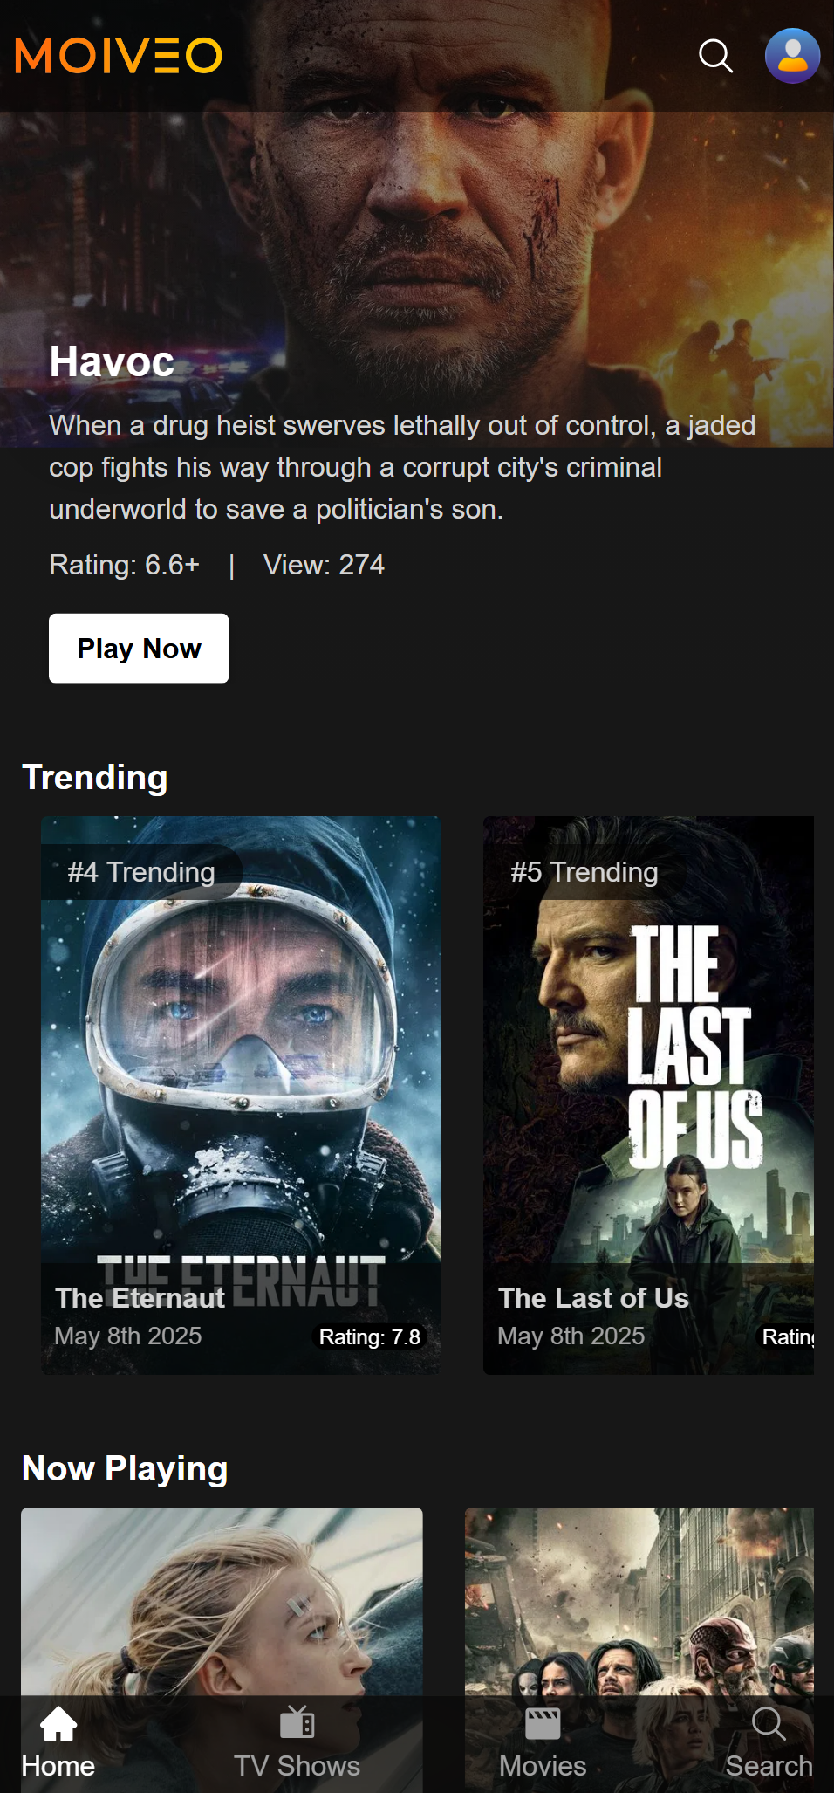
Challenges Faced
API Integration:
Handling TMDB API rate limits and errors.
Responsive Design:
Ensuring consistent UI across devices.
State Management:
Managing dynamic data updates for search and sections.
Deployment:
Configuring Vercel for seamless deployment.
Performance:
Optimizing image loading and API response times.

Slide 7
Solutions
API Integration:
Implemented error handling and caching for API calls.
Responsive Design:
Used TailwindCSS for flexible, mobile-first layouts.
State Management:
used Redux and considered a tree flow states.
Deployment:
Automated Vercel deployment with CI/CD pipeline.
Performance:
Lazy-loaded images and used CDN for faster API responses.

Slide 8
Experience Gained
Technical Skills:
Proficient in React.js, API integration, and TailwindCSS.
Learned Vercel deployment and environment configuration.
Team Collaboration:
Improved Git workflows and task delegation.
Problem-Solving:
Tackled real-world issues like API limits and UI optimization.
Project Management:
Gained experience in planning and executing a Frontend project.

Slide 9
Future Improvements
Enhanced Features:
Add user authentication for personalized watchlists.
Implement offline caching for better accessibility.
Add Filters to the search page
Performance:
Optimize bundle size with code splitting.
Use server-side rendering for faster initial loads.
UI/UX:
Introduce light/dark mode toggle.
Enhance search with filters (genre, year).
Scalability:
Integrate a backend (e.g., Node.js) for custom APIs.
Support multiple streaming sources beyond TMDB.

Slide 10
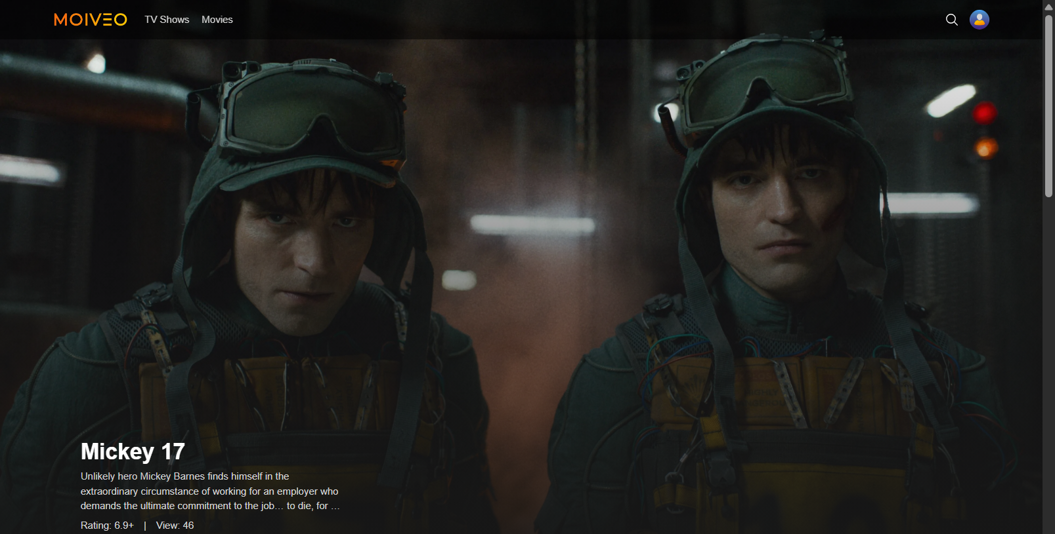
Screenshots of the website
Home page

Slide 11
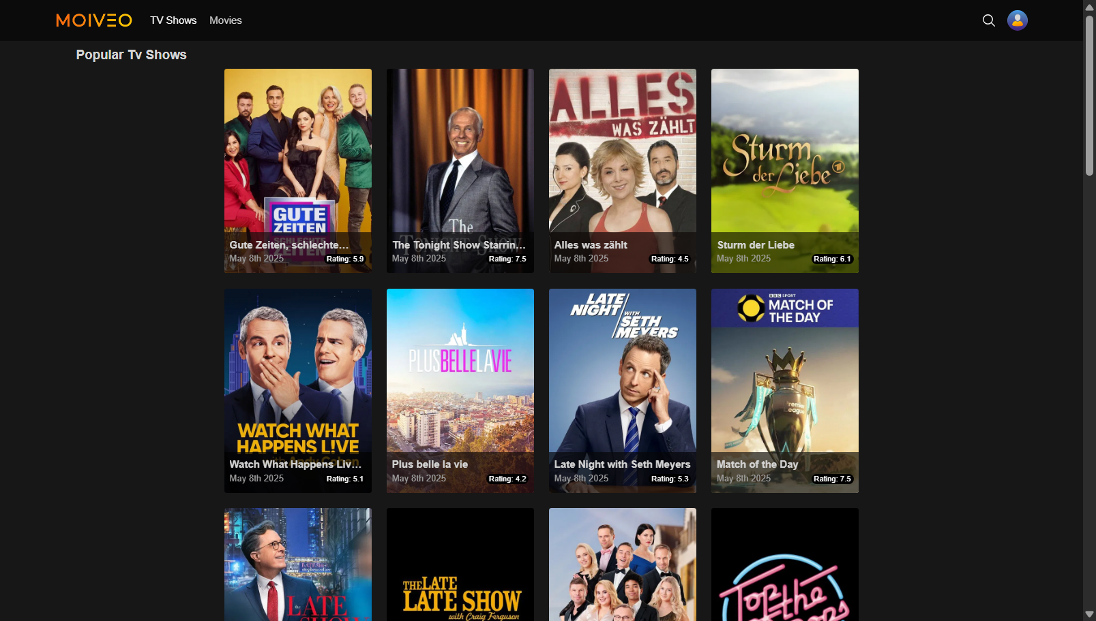
Screenshots of the website
TV shows page

Slide 12
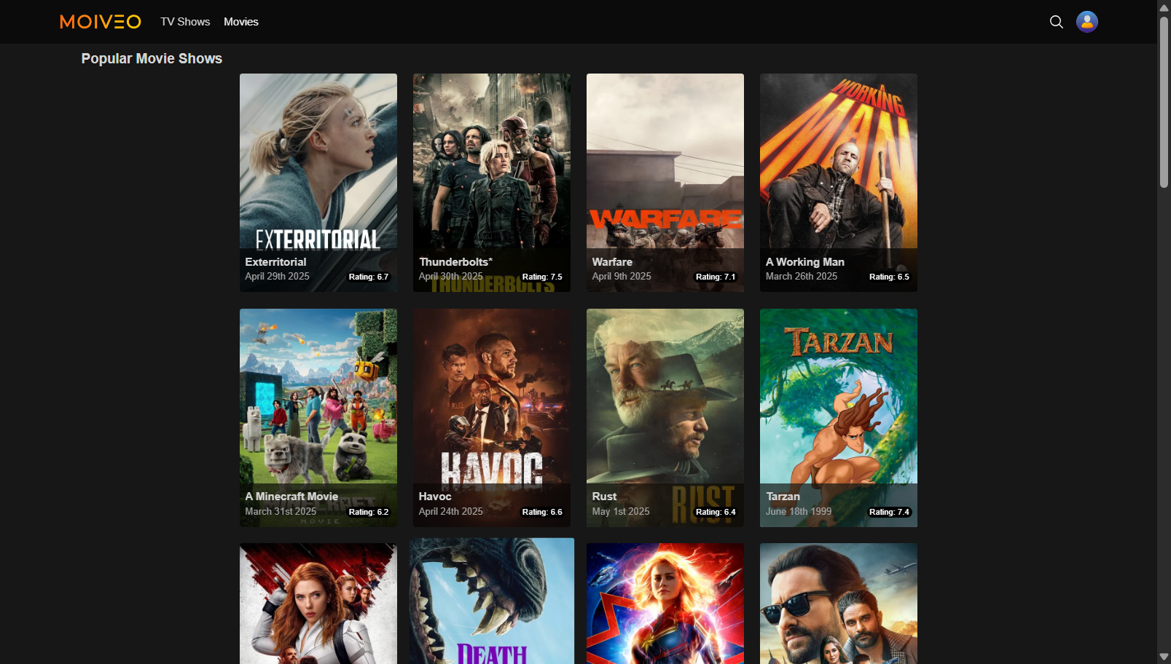
Screenshots of the website
Movies Page

Slide 13
Screenshots of the website
Search Page

Slide 14
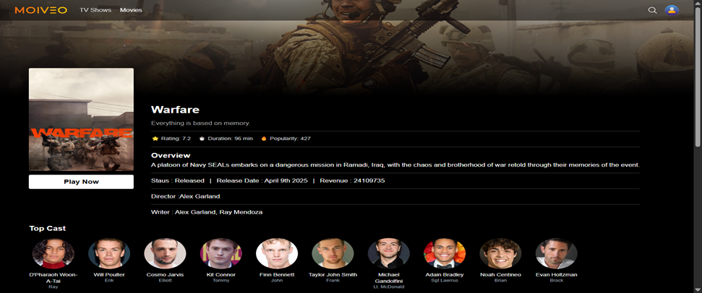
Screenshots of the website
Search Page

Slide 15
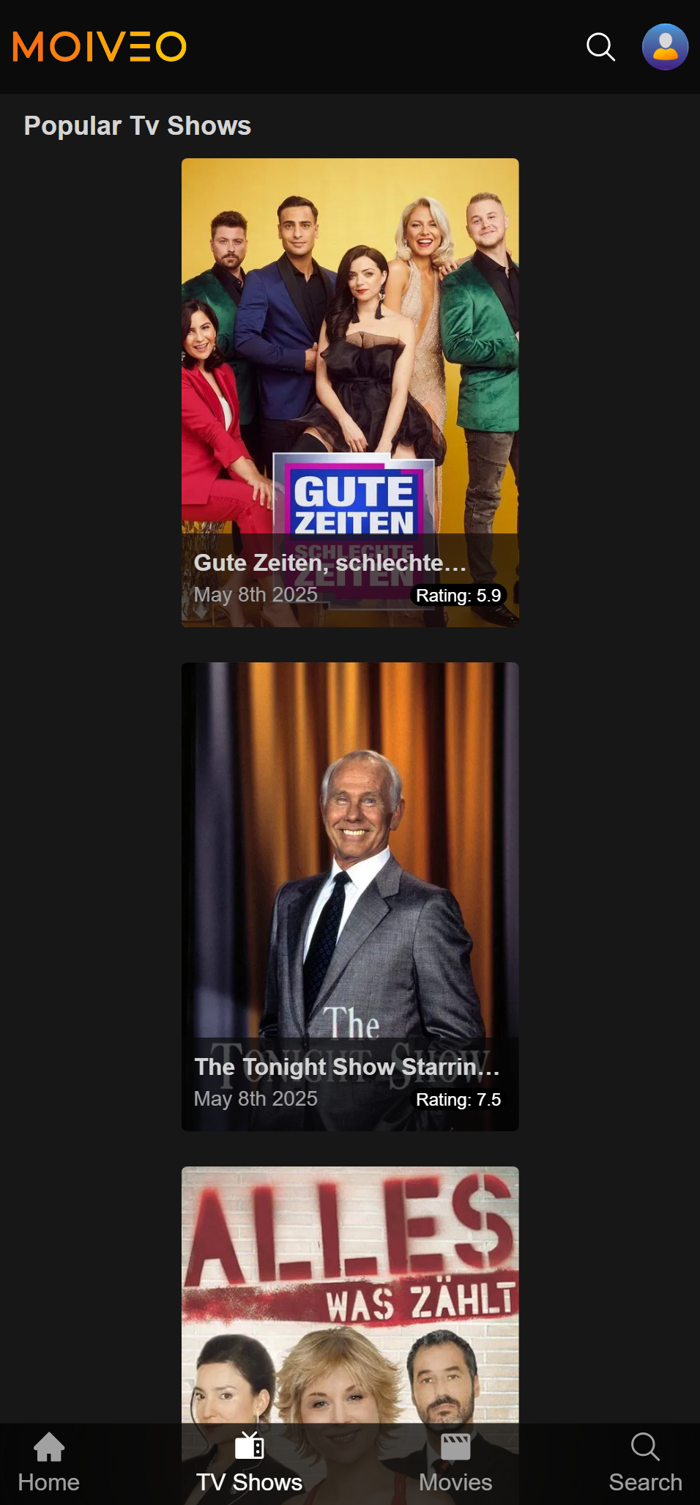
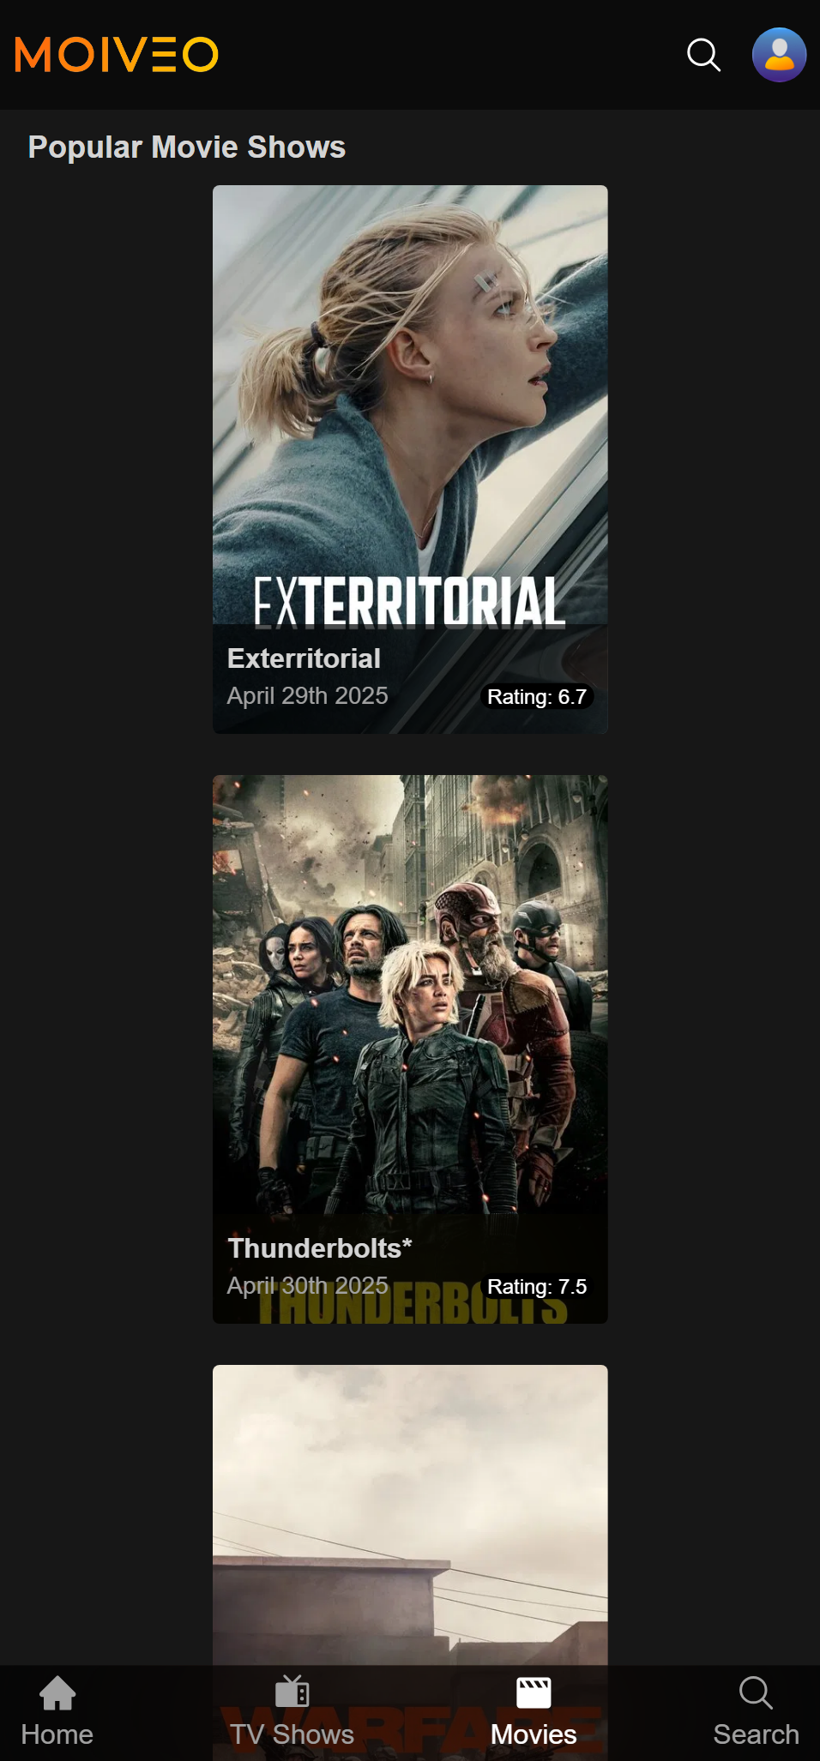
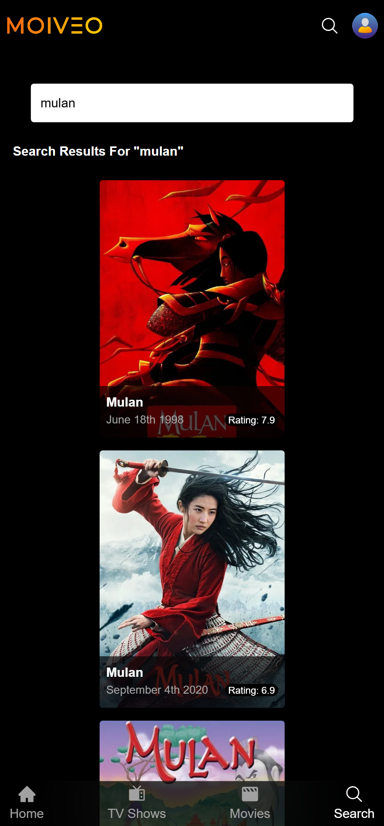
Mobile web app
Home page
Tv show page
Movie page
Search page

Slide 16
Conclusion
MOIVEO: A functional, user-friendly streaming platform.
Achievements: Overcame technical challenges, delivered a responsive app.
Future: Expand features, improve performance, and enhance user experience.
Contact: DEPI TEAM for feedback or support.

Slide 17
Website Url
https://movie-recommendation-nu-five.vercel.app/
Github files:
Movie-Web-App-Files

